Slide 1
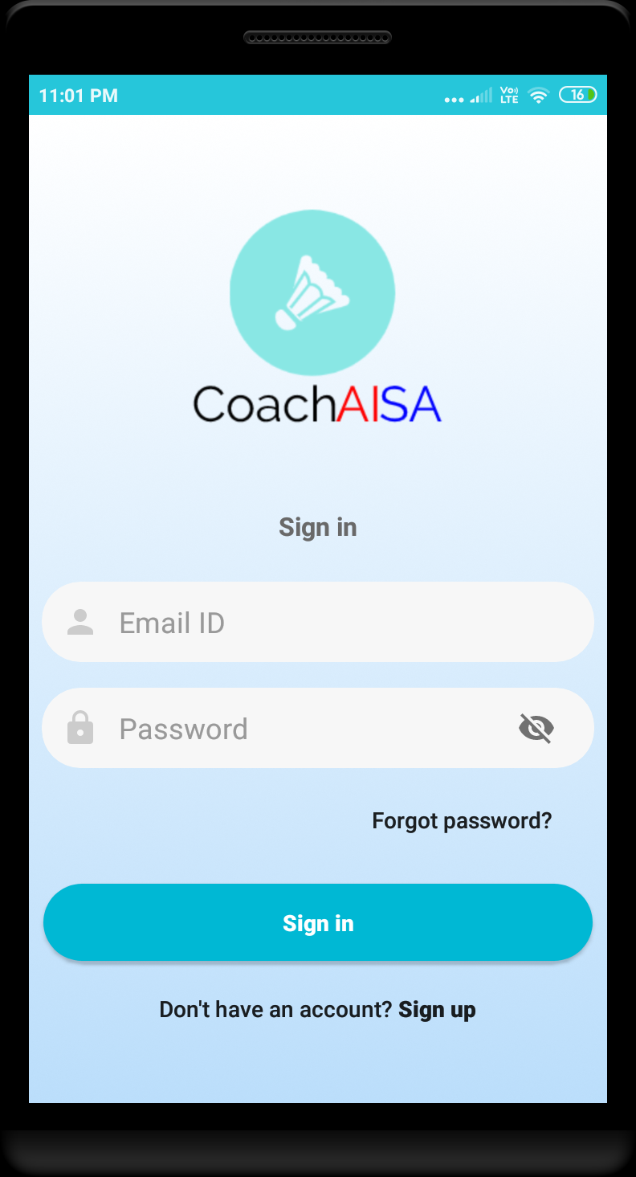
Login
If the user is new, register by tapping on “Don’t have an account? Sign Up” which will redirect to the SIGN UP page. Else enter the registered E-mail ID and associated password to sign in to the app.

Slide 2
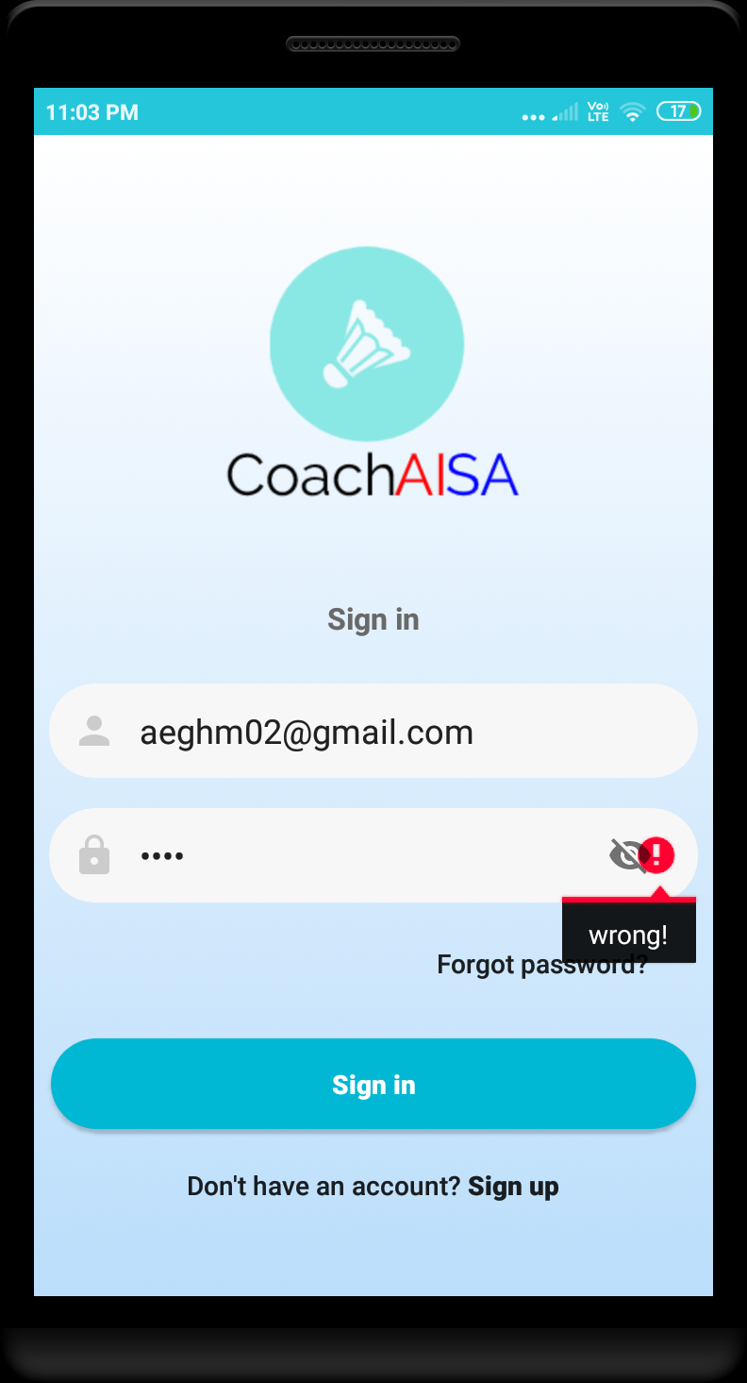
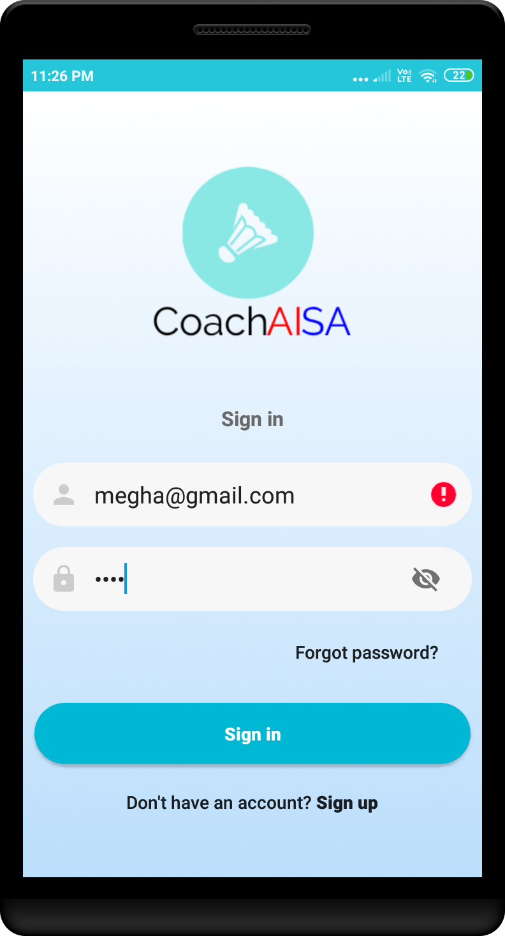
Pic 1. When wrong password is entered.
Pic 2. When the E-mail ID is either not registered or not mapped to the coach by admin. In both the cases it indicates that “You are not mapped!!”
To map the coach and player, refer slide#3
Pic 1
Pic 2

Slide 3
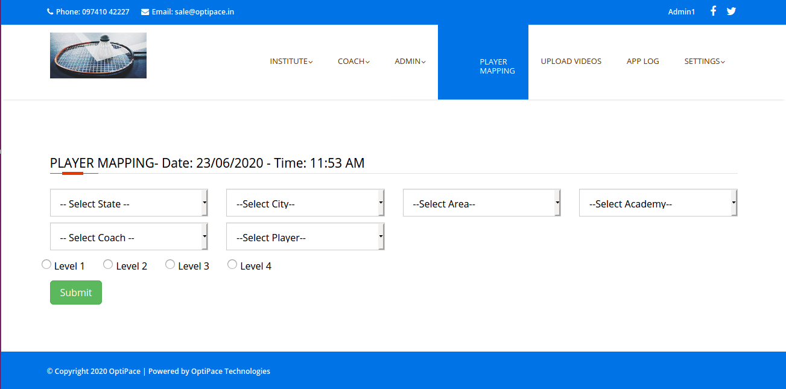
Registered Player mapping to Coach and setting level on website by the admin

Slide 4
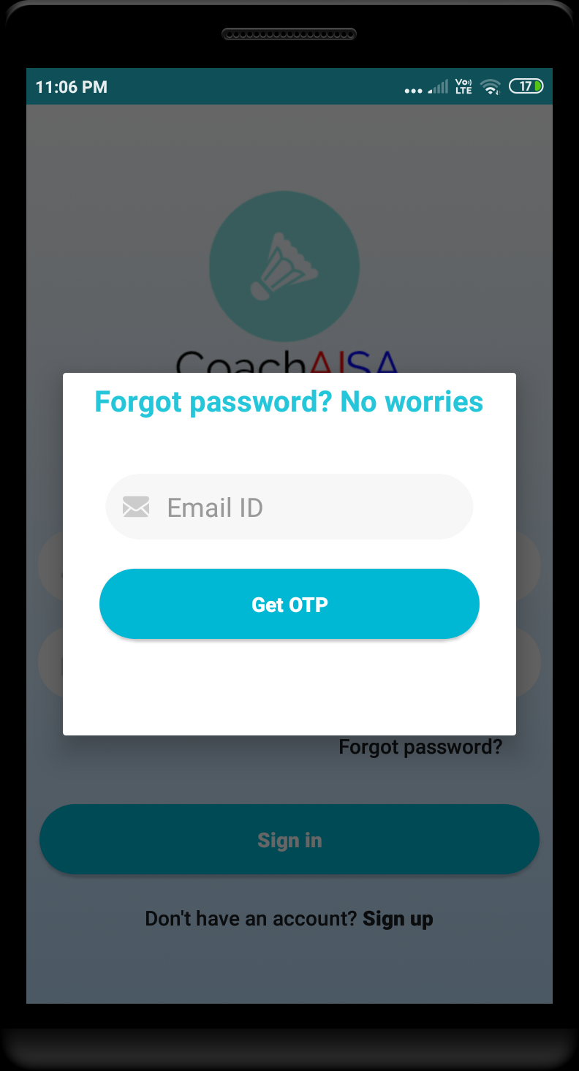
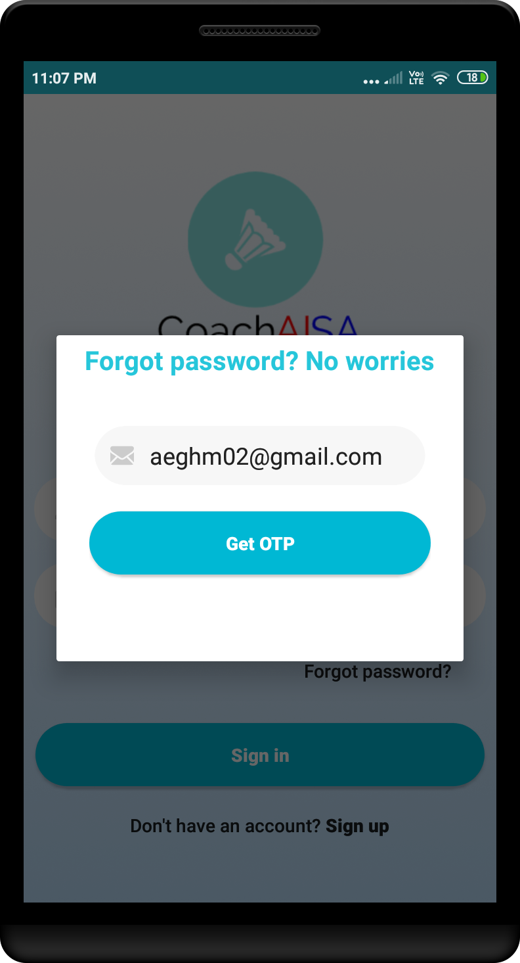
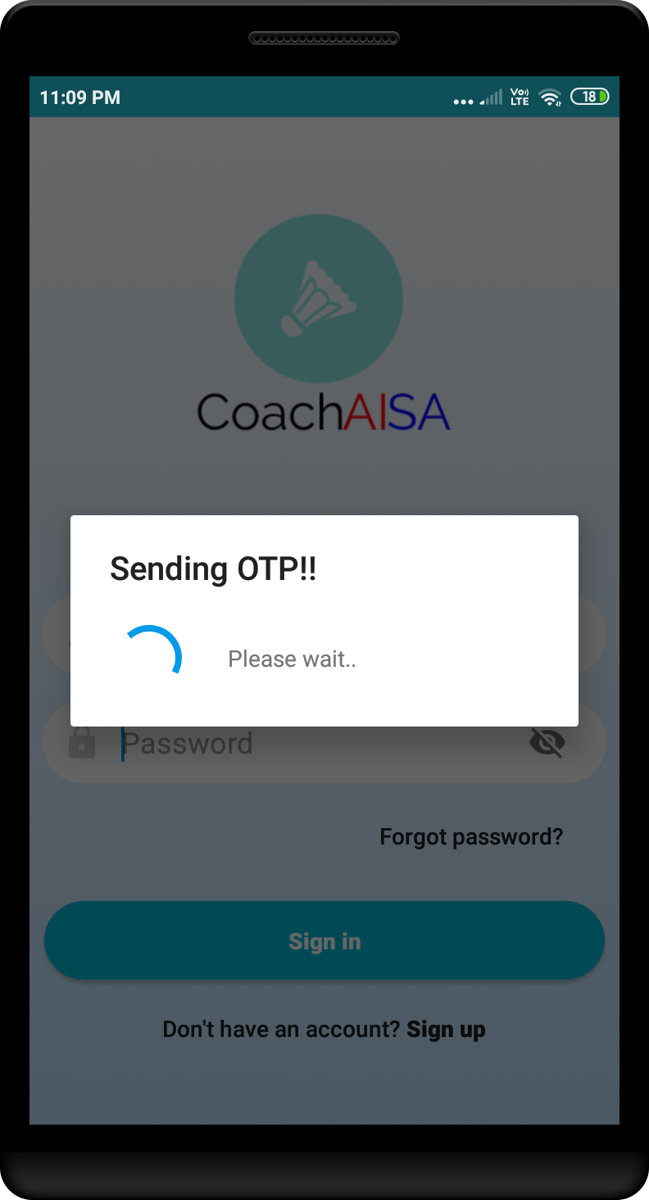
Forgot Password
Pic 1
Pic 2
Pic 3
Pic 2. Enter the Email ID.
Pic 3. After entering the Email ID, OTP is sent.

Slide 5
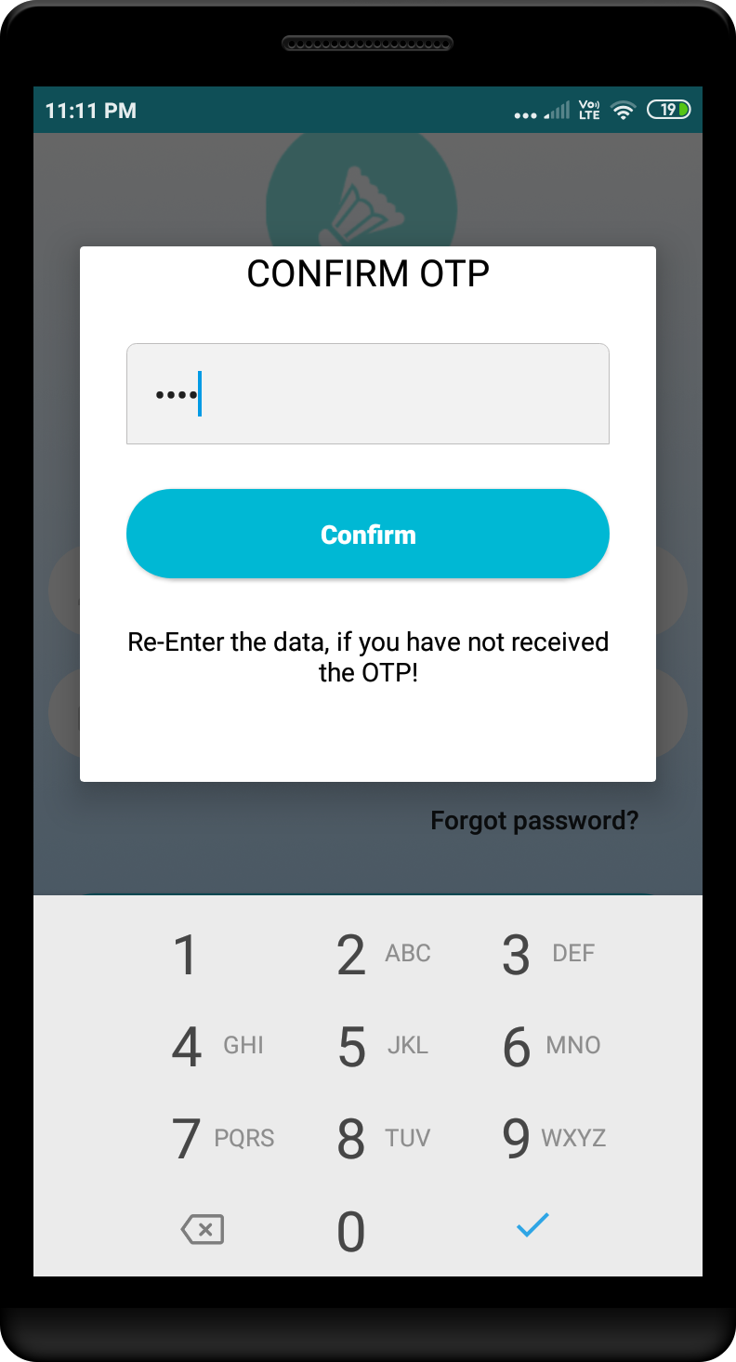
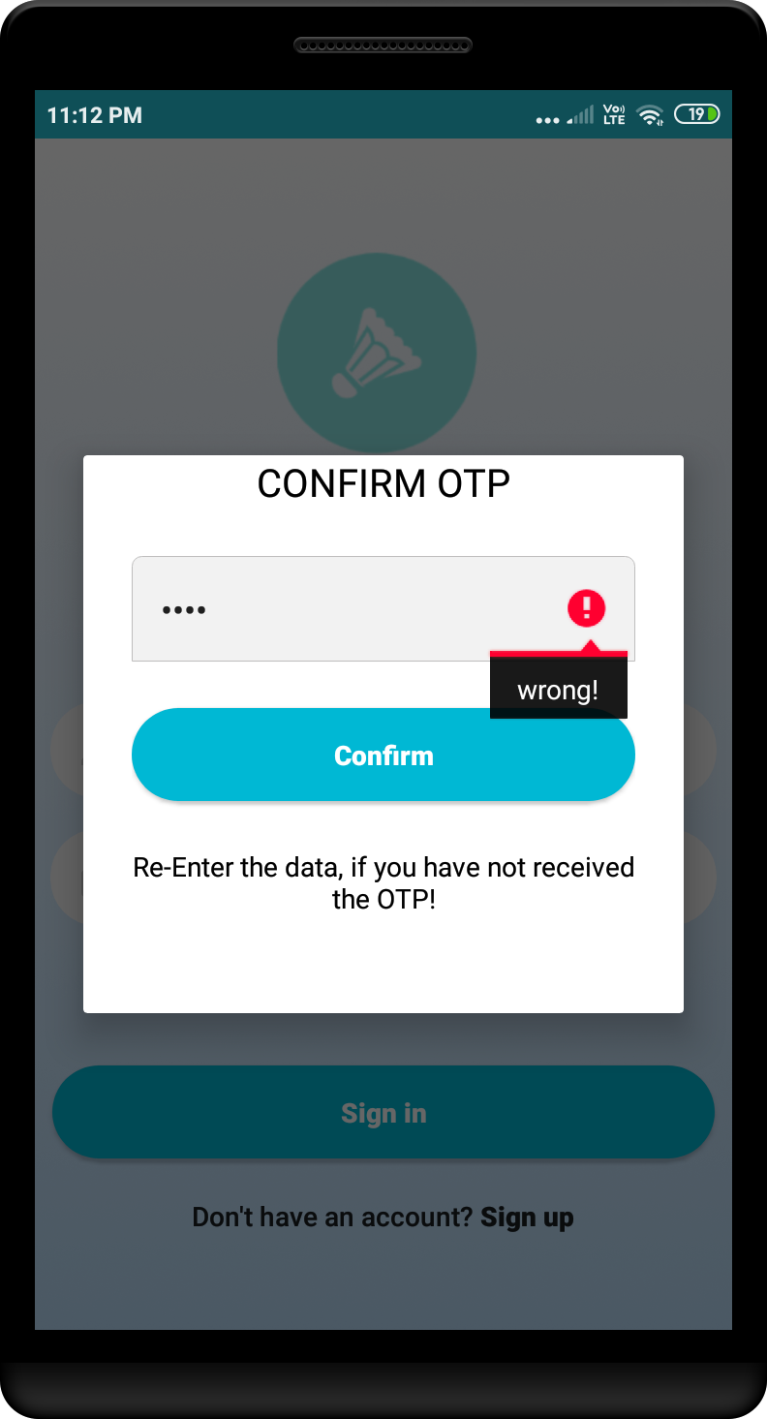
Pic 1. OTP is entered.
Pic 2. When wrong OTP is entered
Pic 1
Pic 2

Slide 6
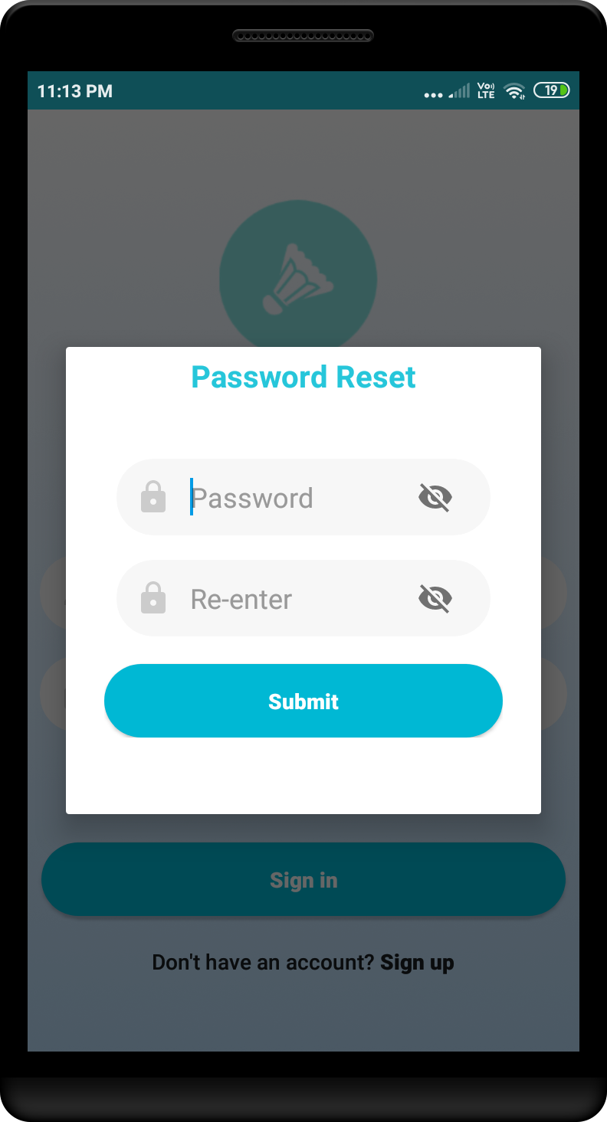
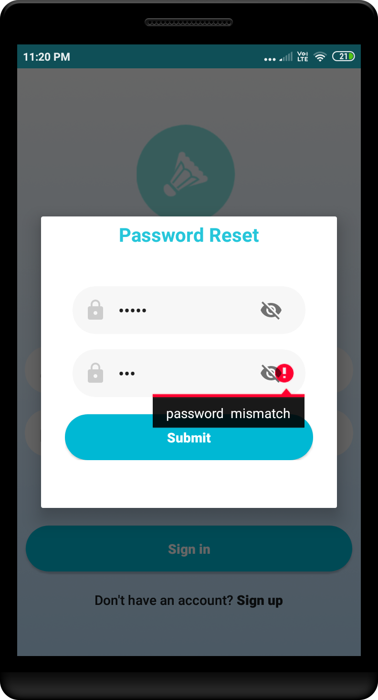
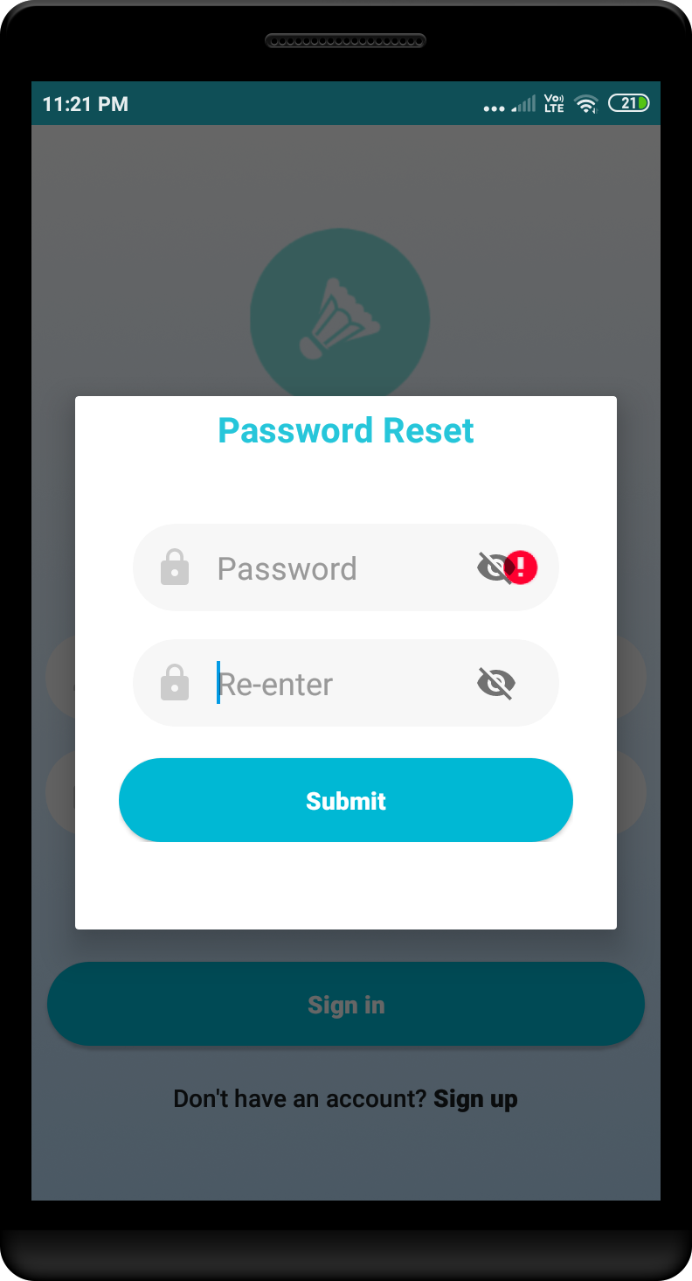
Pic 1
Pic 2
Pic 3
Pic 1. After validation of OTP, asks to reset the password
Pic 2. Password match validation, if both the password doesn’t match with each other.
Pic 3. Password match validation, when password is kept empty

Slide 7
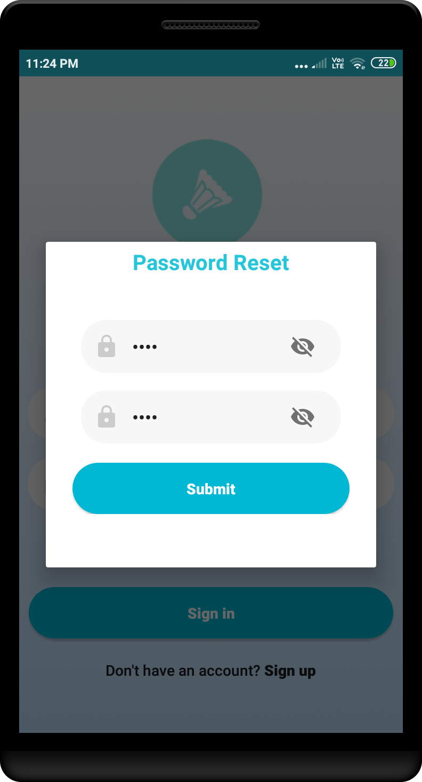

Pic 1
Pic 2
Pic 1. Password validation.
Pic 2. Once the password is reset, user is successfully logged in.

Slide 8
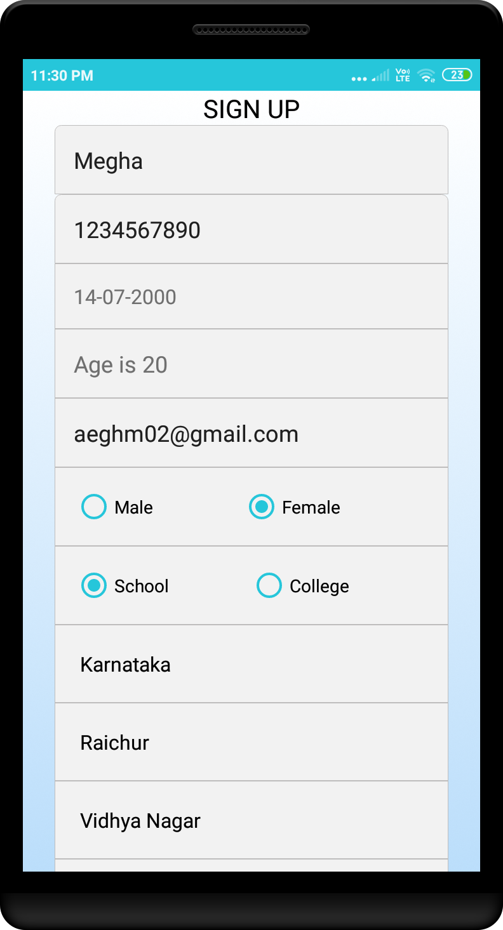
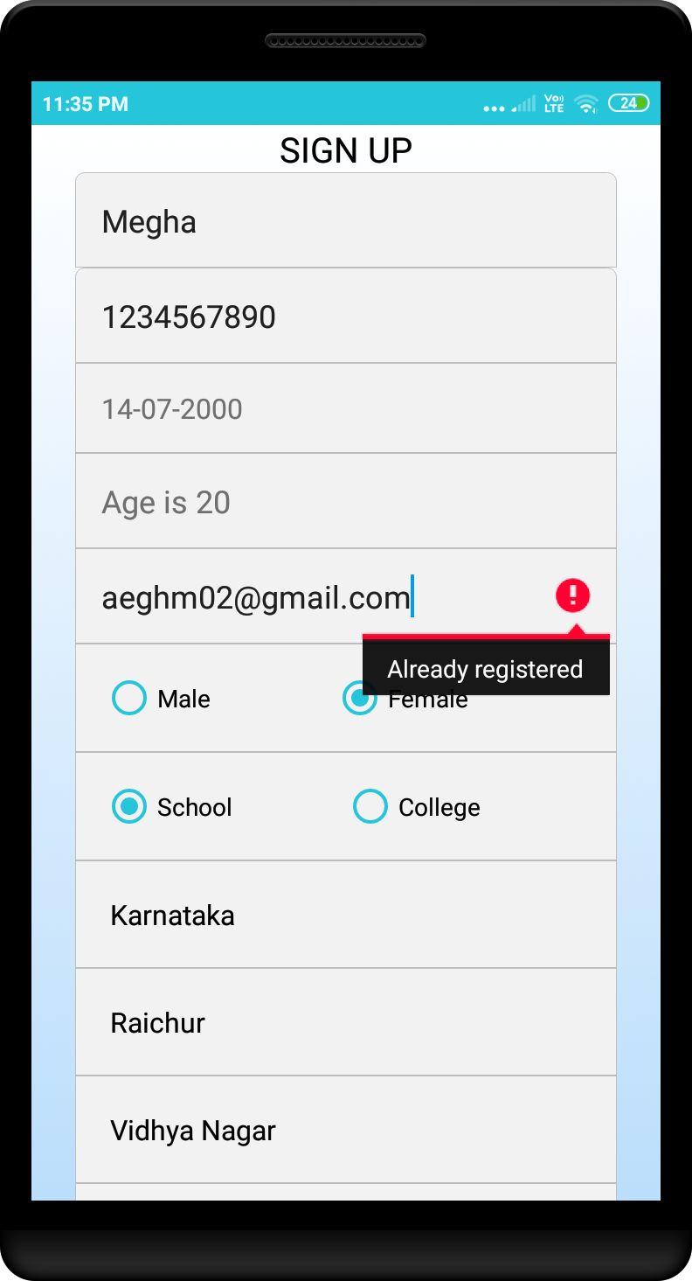
Registration
When the user is new and haven’t registered to the app, fill all the proper details.
Field validations:
Name : name length should be more than 2 character.
Phone number : either takes 10 or 13 digits(which includes +91)
Age: age should be more than 5 years.
Pic 1
Pic 2
Pic 1. Enter the fields.
Pic 2. If E-Mail ID already exists, notifies “Already registered”

Slide 9
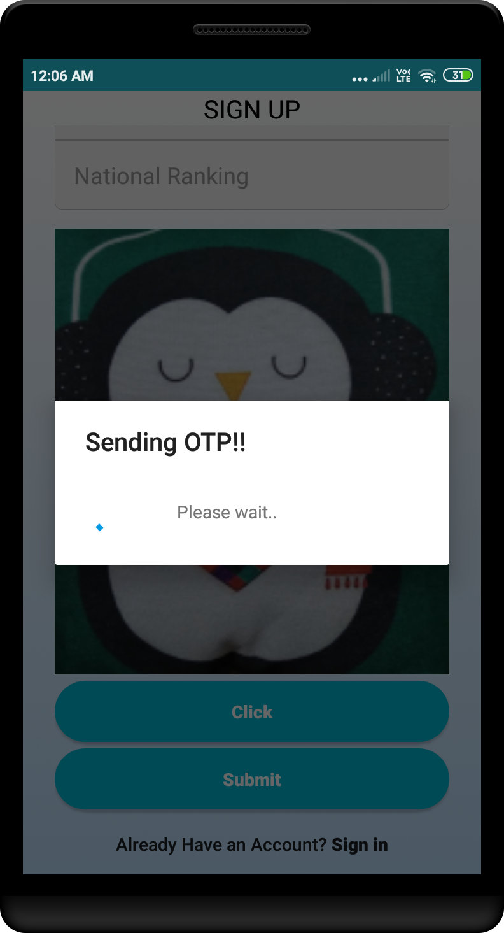
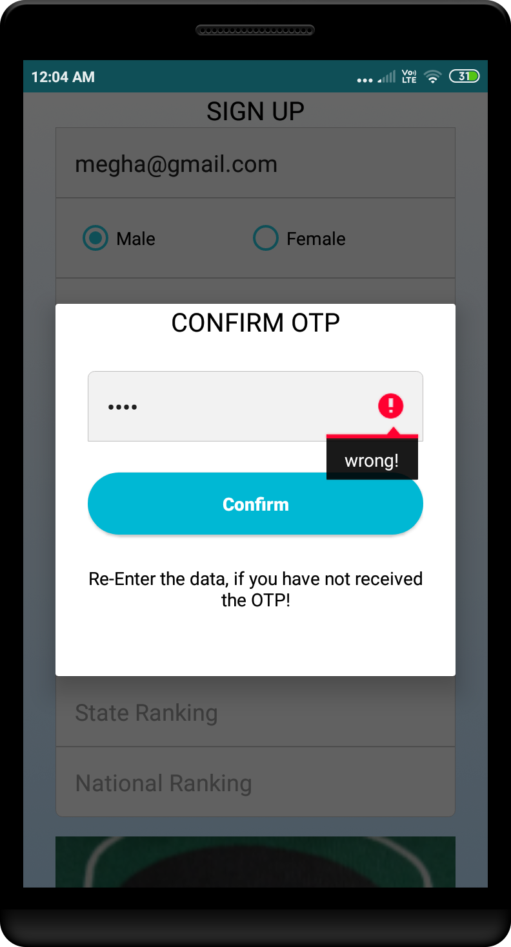
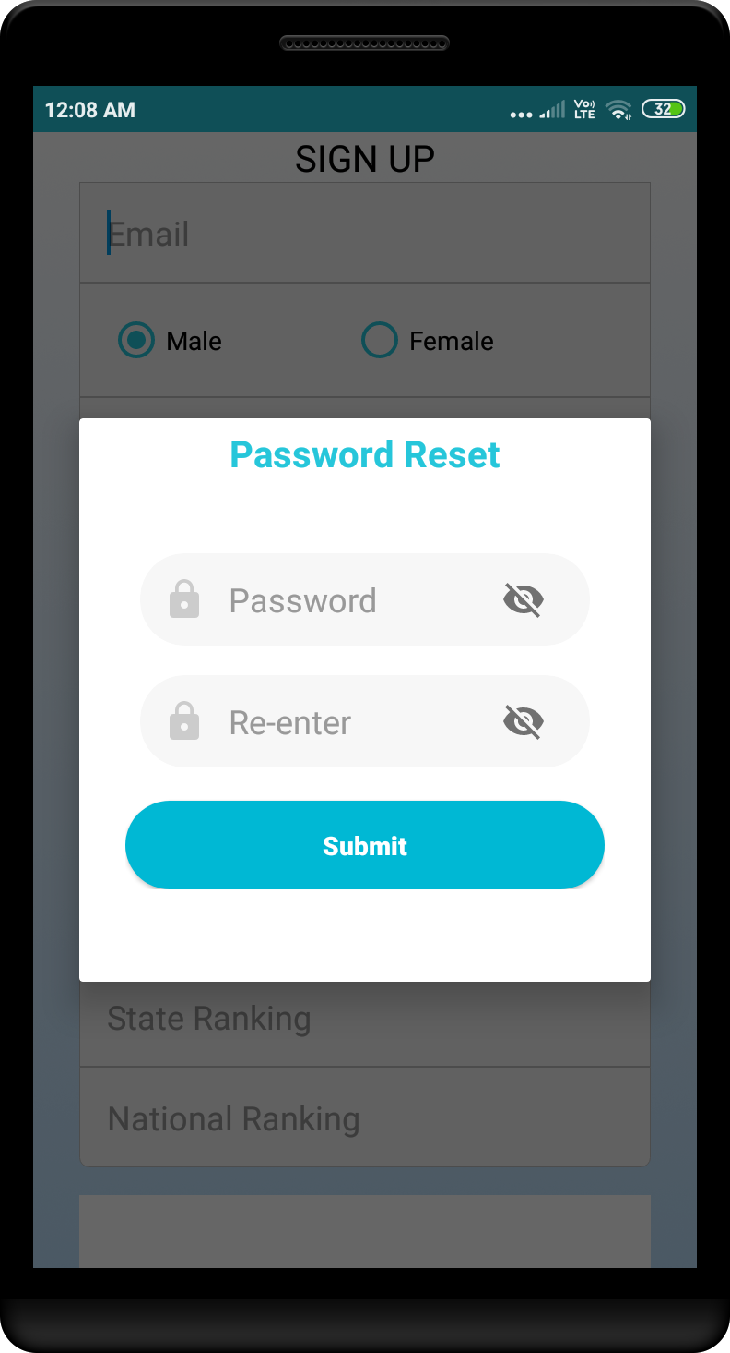
Pic 1
Pic 2
Pic 3
Pic 1. after all the fields entered, OTP is sent.
Pic 2. Enter the OTP, if OTP entered is wrong, notifies “wrong”.
If correct OTP entered, notifies “Registered Successfully”.
Pic 3. After successful registration, Askes to reset the password. After resetting the password, user needs to login.

Slide 10

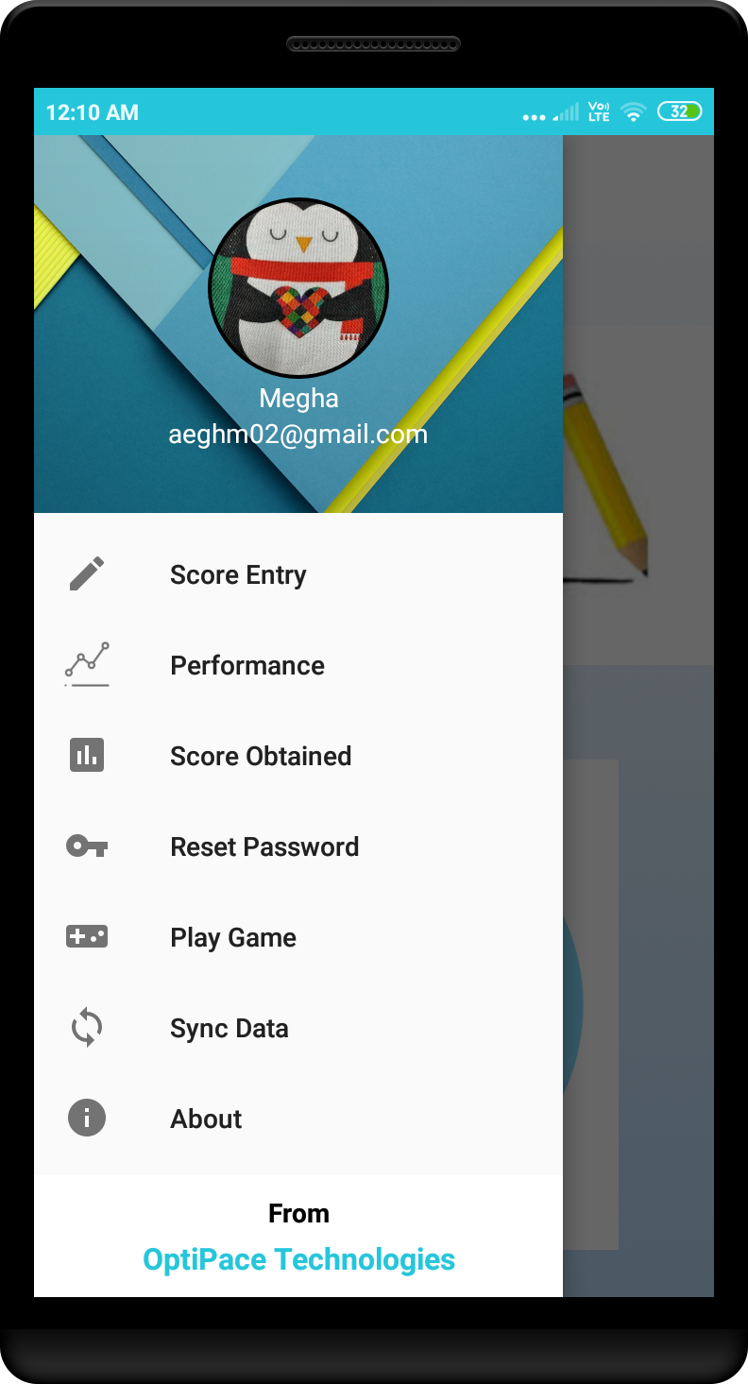
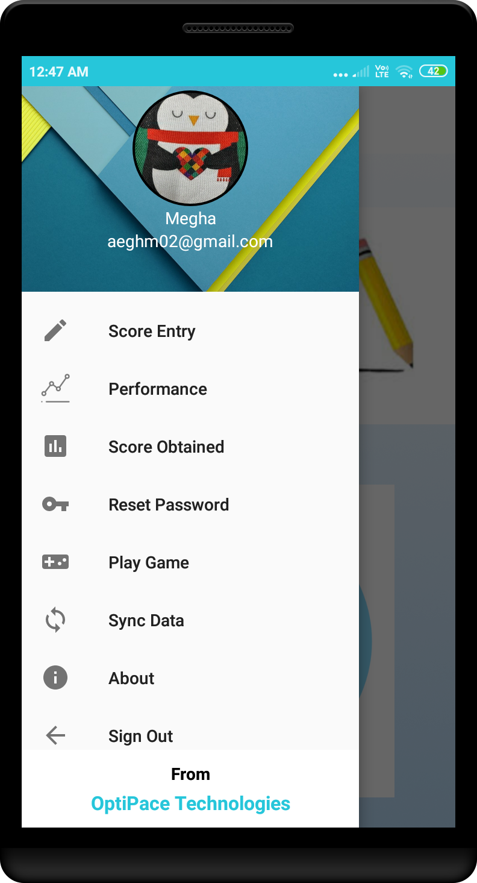
Login: Player
Pic 1
Pic 2
Pic 3
Pic 4
Pic 1. Enter the login credentials.
Pic 2. The player options are available on tapping on left corner menu button.
Pic 3 and Pic 4. scroll the menu to see the other options.

Slide 11
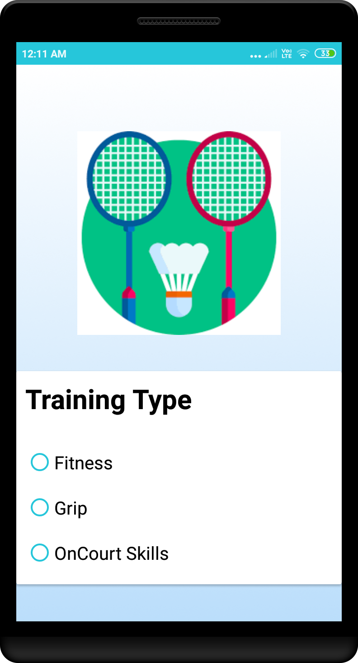
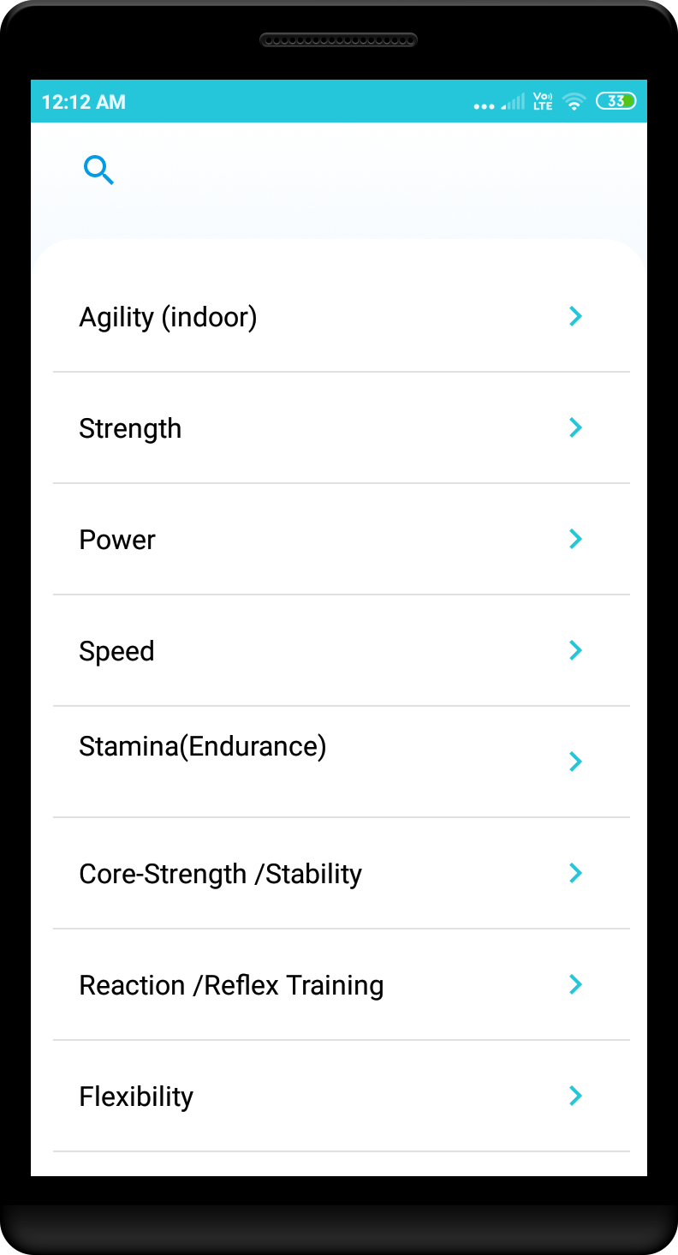
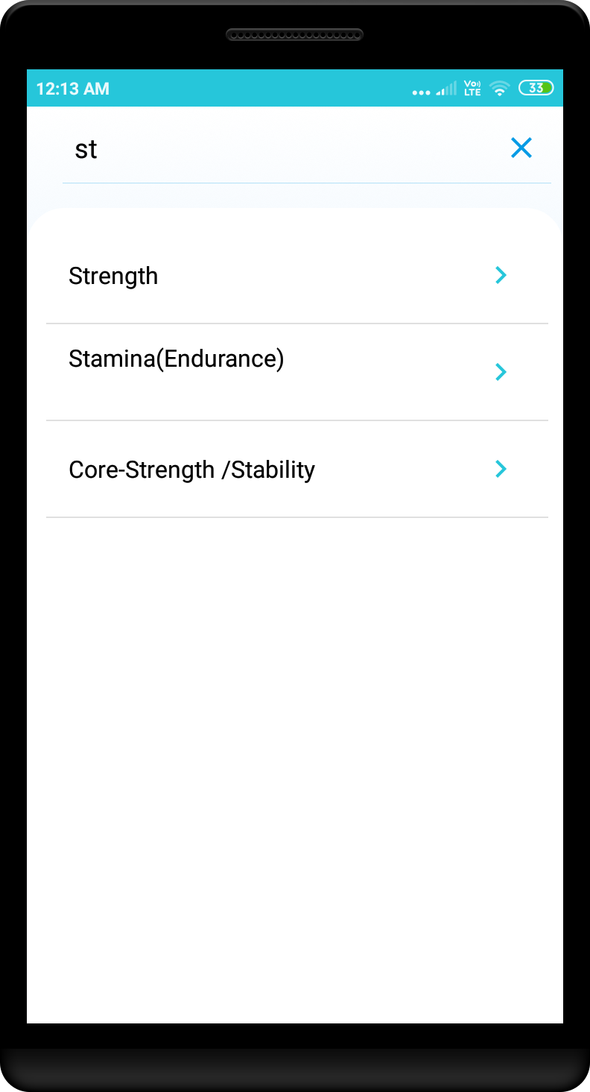
Score Entry
Pic 1
Pic 2
Pic 3
Pic 1. Enter the required option,
Pic 2 and Pic 3. Select the subtype, also can search the subtype.

Slide 12
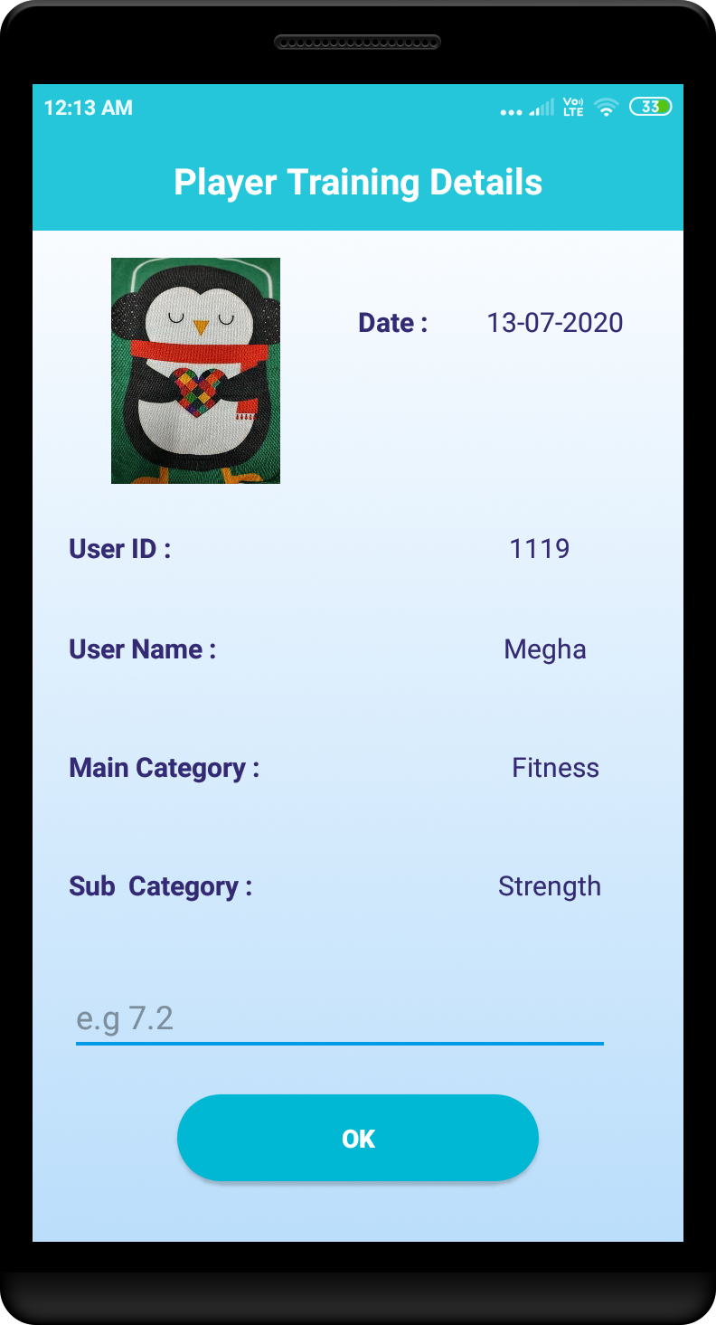
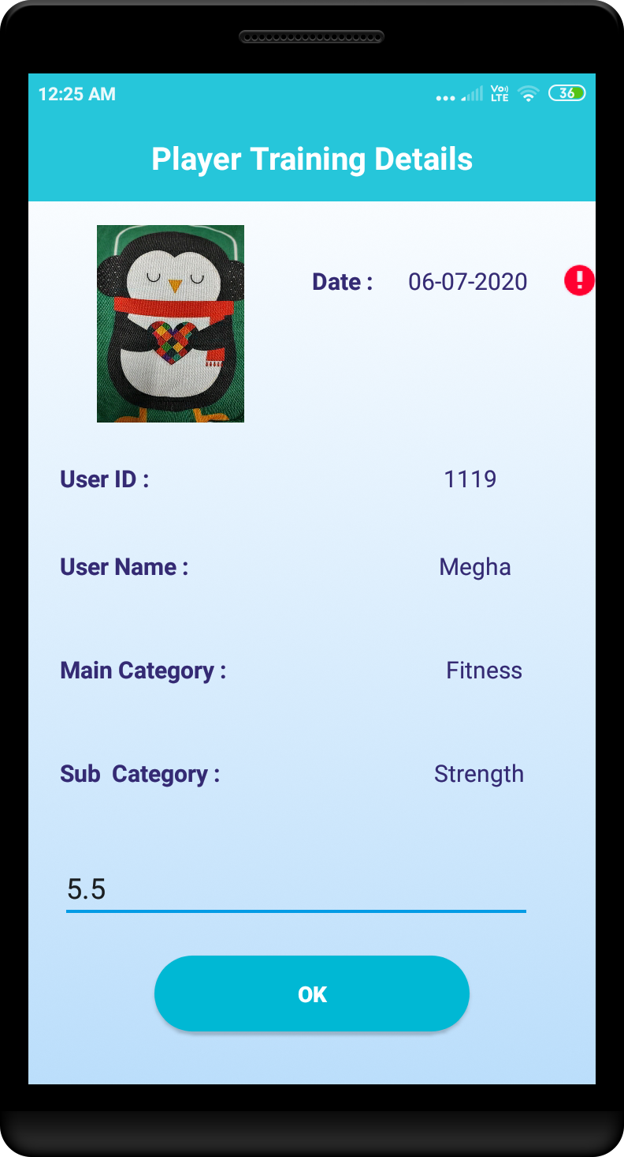

Pic 1
Pic 2
Pic 3
Pic 1. The date displayed is the date after the last score date(12/07/2020) i.e, 13/07/2020. Pic 2 and Pic 3. validation for date before registration and future date respectively. Registration date is “11/07/2020” for player id 1119.

Slide 13
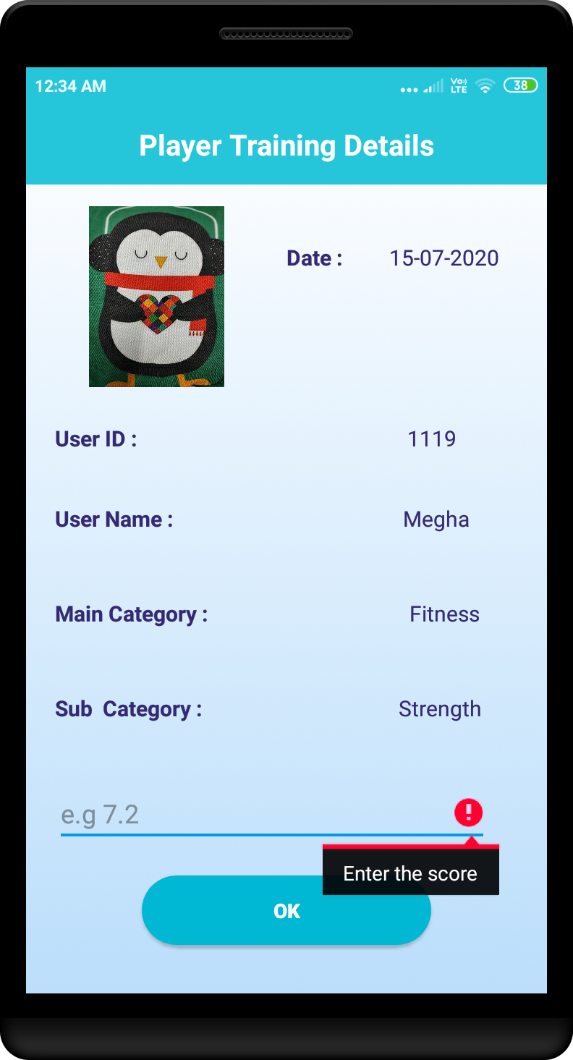

Pic 1
Pic 2
Pic 1. When score is kept empty.
Pic 2. Enter proper date and tap on OK.
Same score is added to the other dates, Refer slide#13, Pic 1 and slide#14 Pic 2, which are 13/07/2020 and 15/07/2020. The score entered in slide#14 Pic 2, is copied to 13,14,15/07/2020. Refer slide#14, Pic 1.

Slide 14
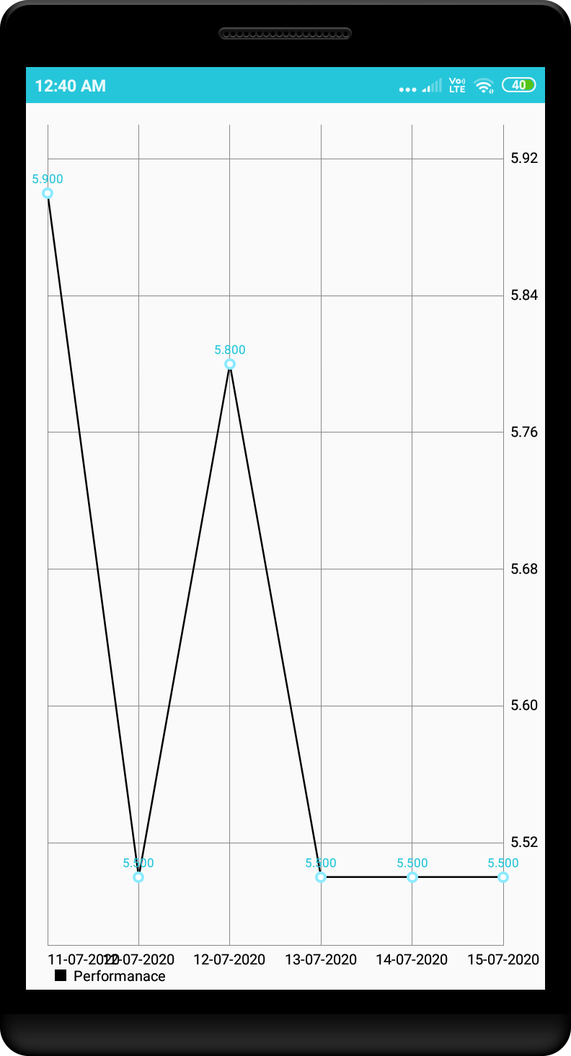
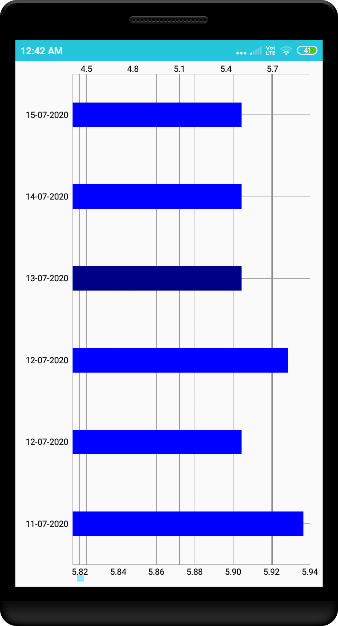
Pic 1
Pic 2
Pic 1. when “Performance” is selected from the menu.
Pic 2. When “Score Obtained” is selected from menu.

Slide 15
Sync Data:
When Sync Data is selected. The data gets synced to server

Slide 16

When Play Game selected from the menu.
Play Game module for android OS version below 6 doesn’t play the video since the media player is not supported and for the version above 6 and below 8 plays the video fine but after resuming the video starts playing from beginning. Works totally fine for version above 7.
Find the link below to view the video:
https://youtu.be/DqyJiHiCDHQ

Slide 17
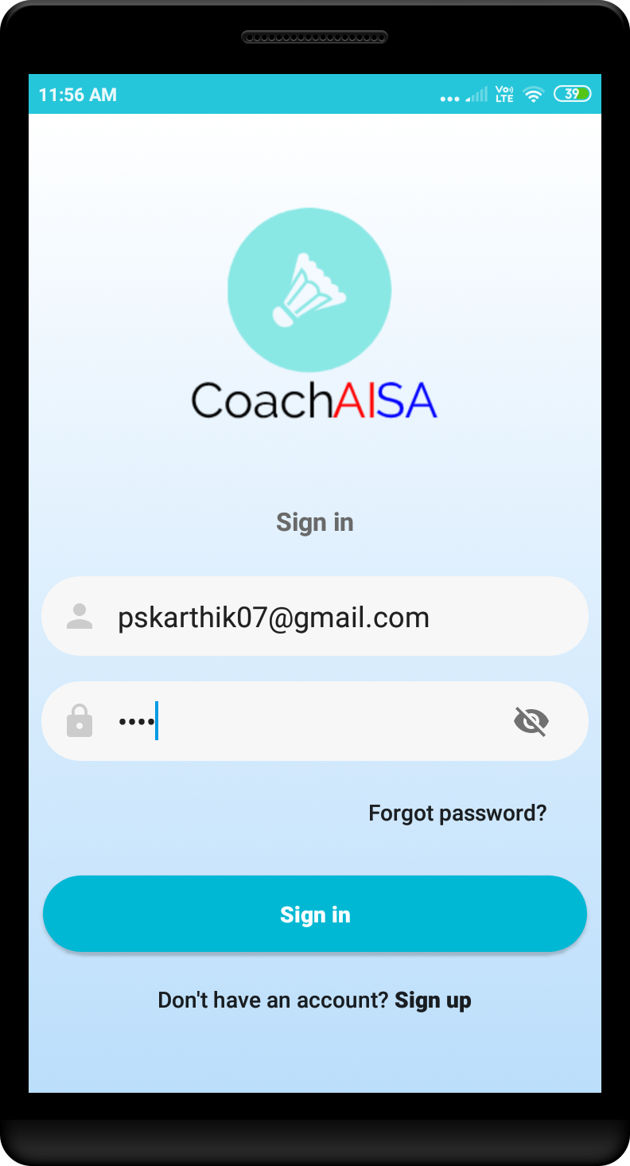
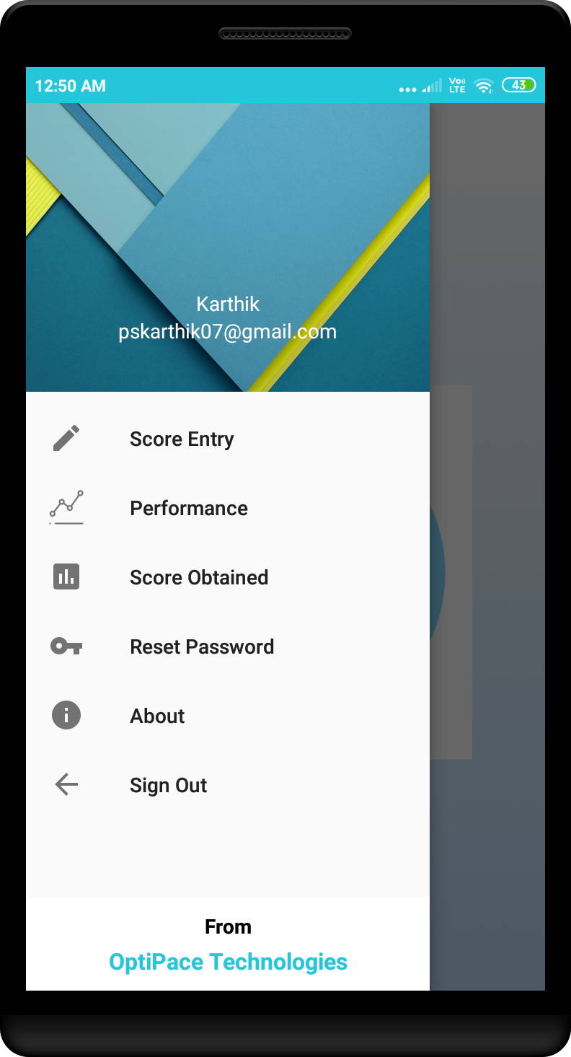
Login: Coach
Pic 1
Pic 2
Pic 1. Coach Login.
Pic 2. after successful login.

Slide 18
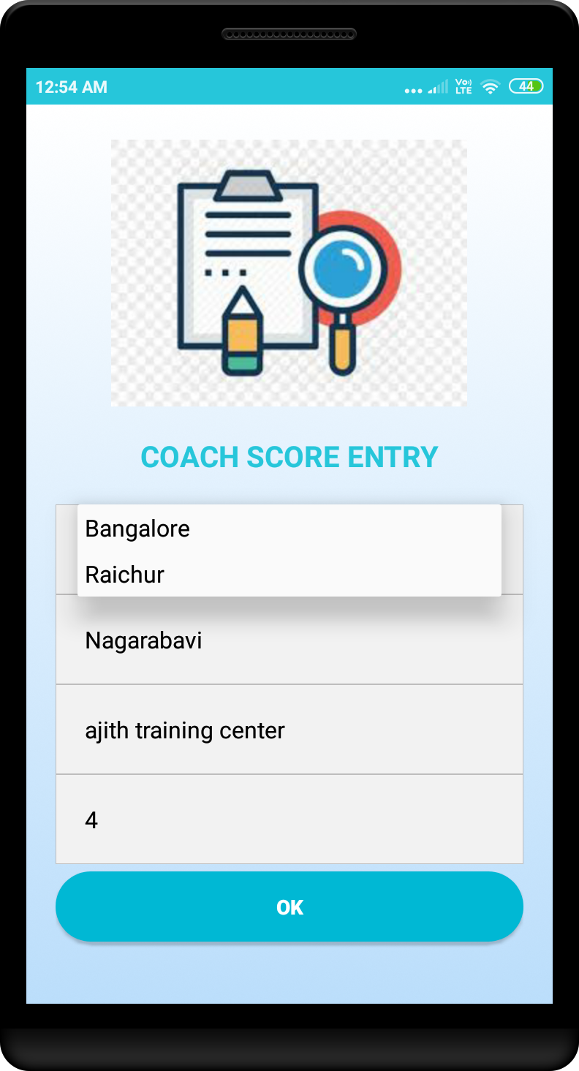
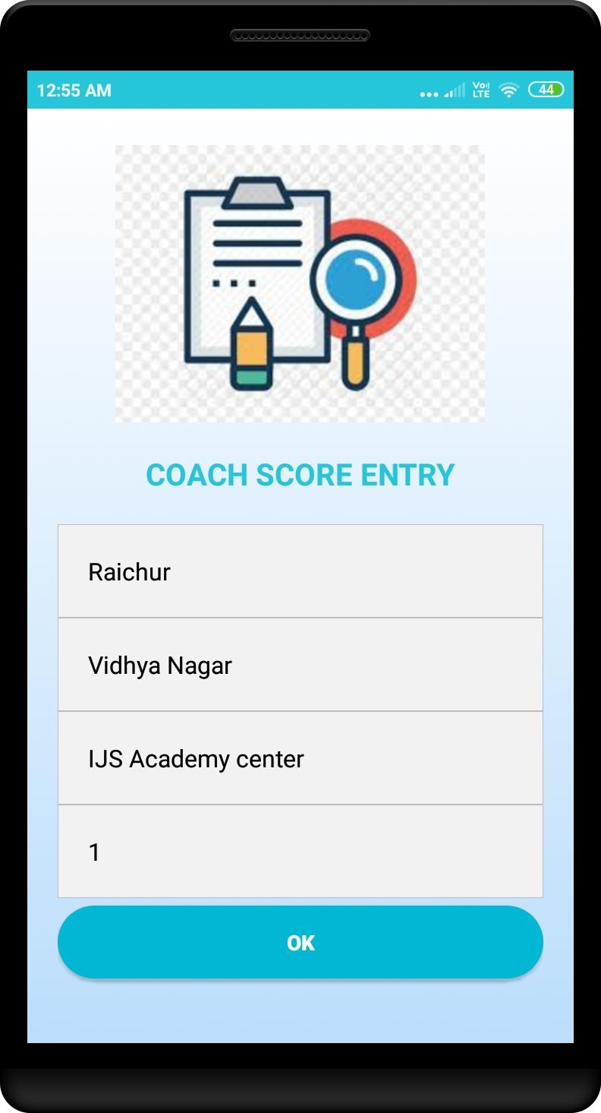
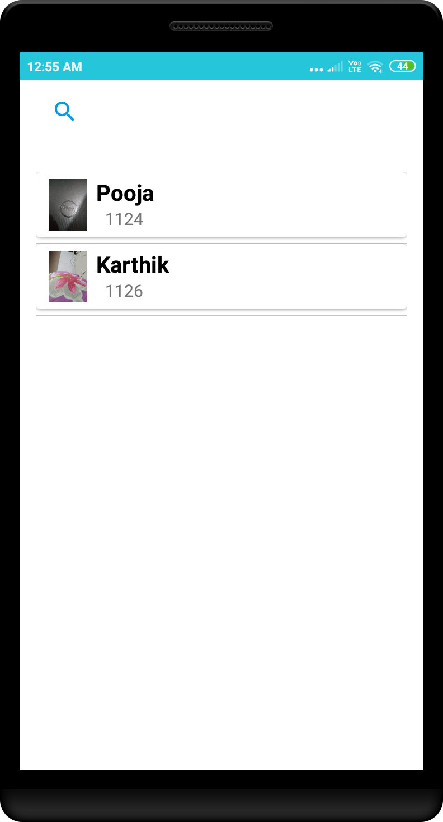
Score Entry
Pic 1
Pic 2
Pic 3
Pic 1. Displays all the academy info for which the coach is associated.
Pic 2 and Pic 3. select the academy and player respectively. Selected second data i.e., “1126” and slide#11 follows.

Slide 19
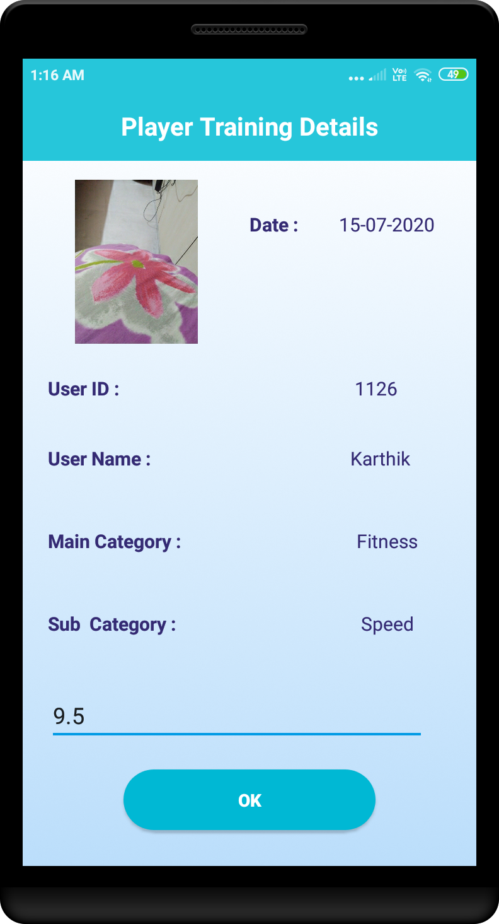
Enter the score and tap on OK and data is synced to the server successfully else notifies “Data failed”

Slide 20
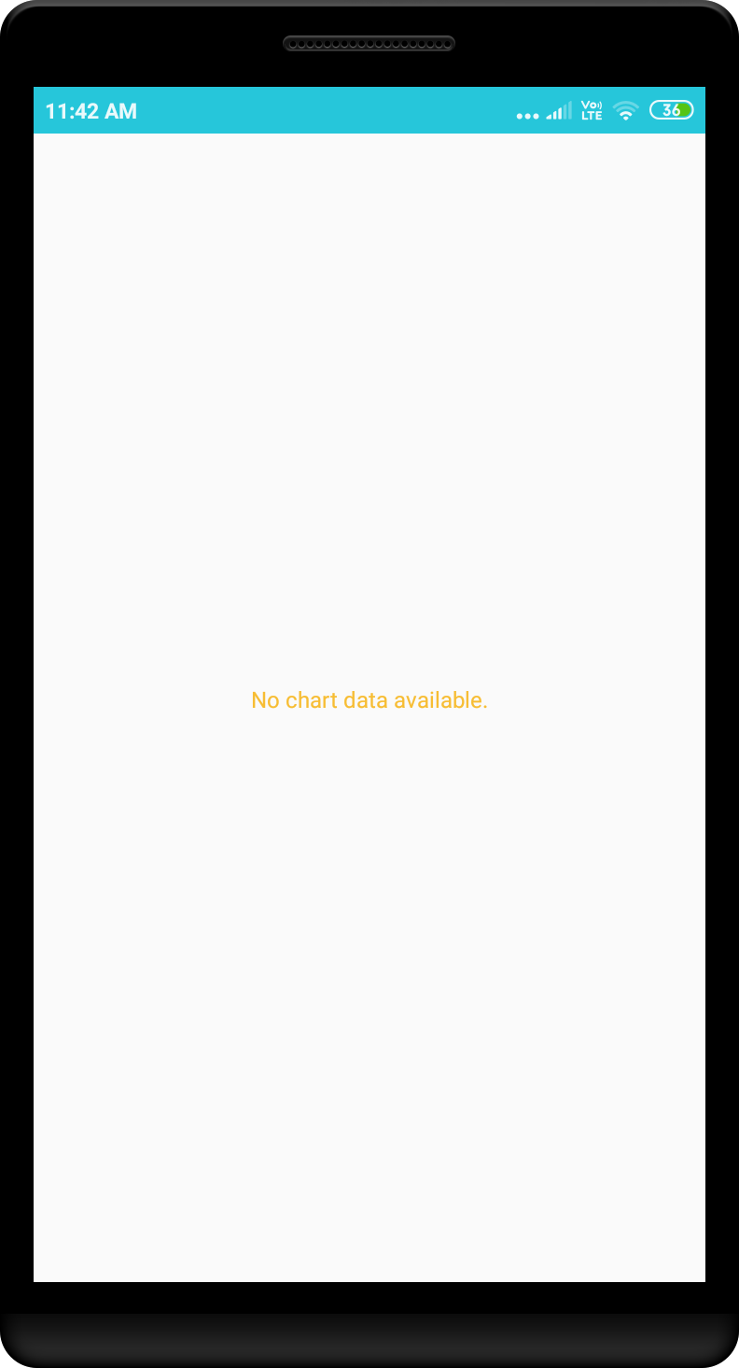
When Performance is selected from the menu, displays “No chart data available” when there is only one score data entered

Slide 21
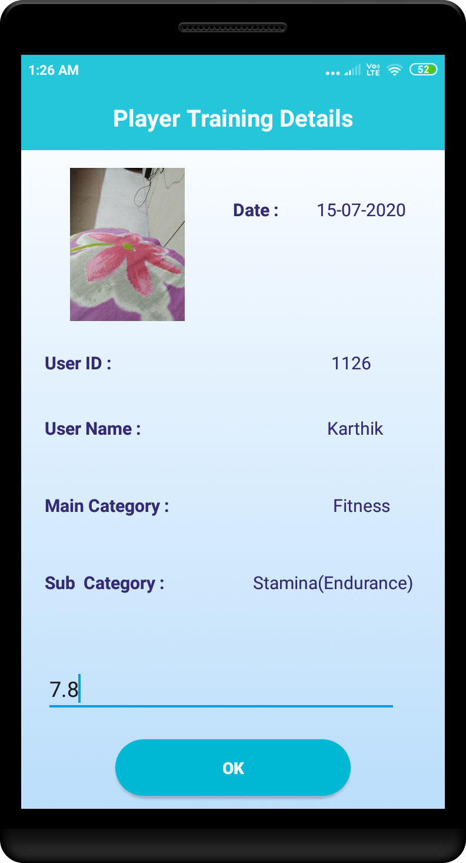
Enter the score again for the player

Slide 22
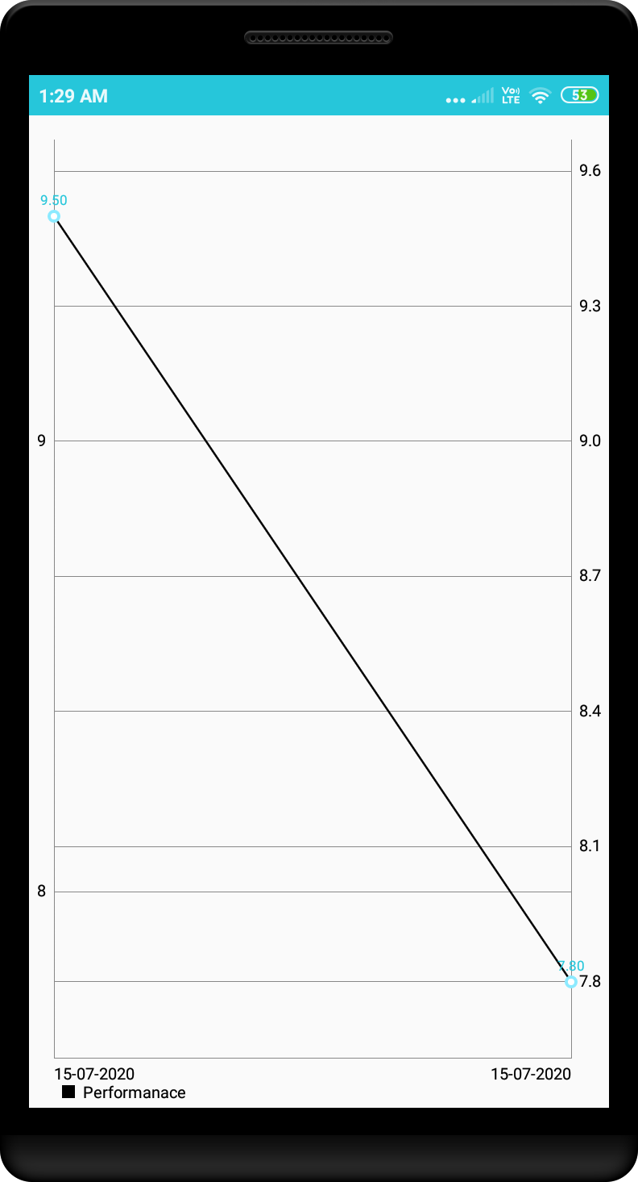
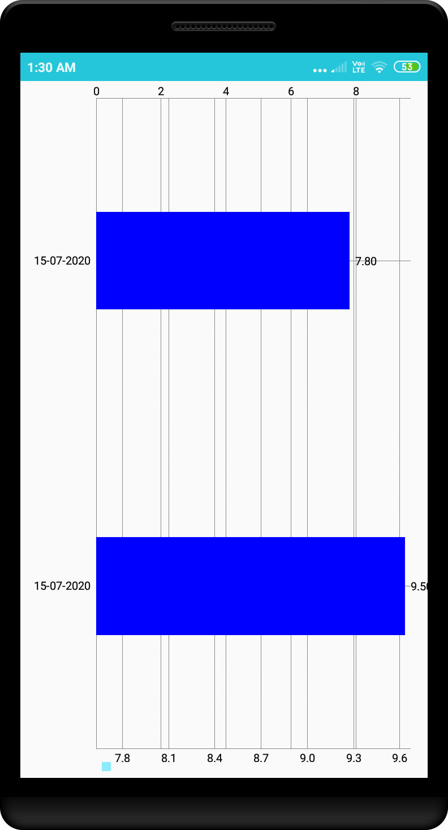
Pic 1
Pic 2
Pic 1. when Performance is selected from the menu.
Pic 2. When Score Obtained is selected from menu.

Slide 23
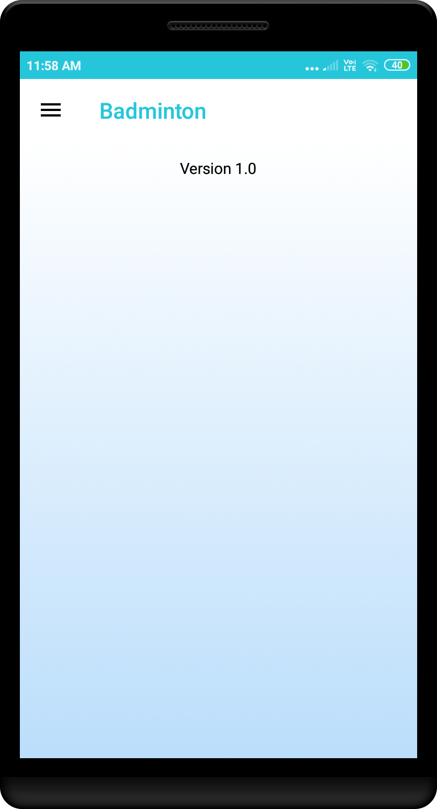
About
When user selects About from the menu

Slide 24
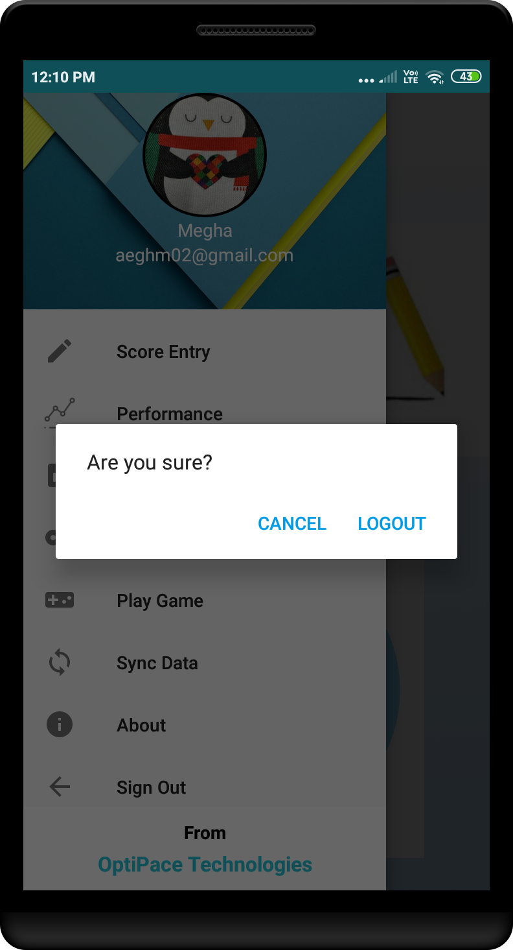
Sign Out

